Slide 1
Immigration
The Irish Experience
Notes:
http://commons.wikimedia.org/wiki/File:Ireland_flag.gif

Slide 2
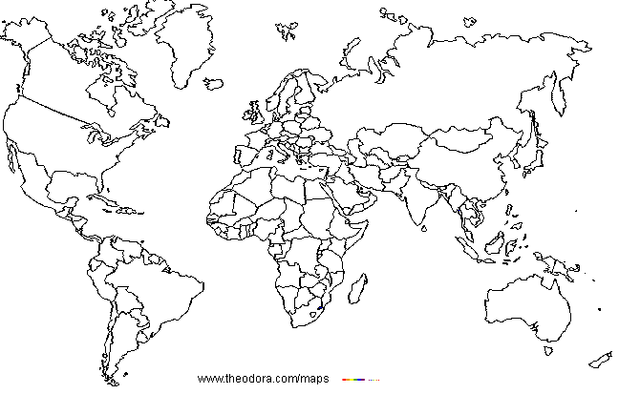
Where is Ireland?
Notes:
Maps courtesy of www.theodora.com/maps used with permission

Slide 3
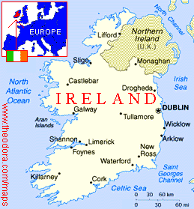
This is Ireland
Notes:
Maps courtesy of www.theodora.com/maps used with permission

Slide 4
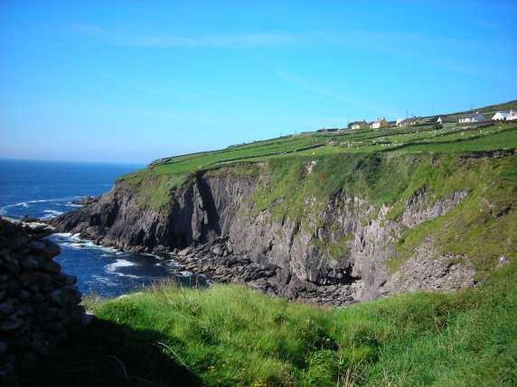
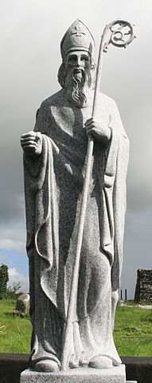
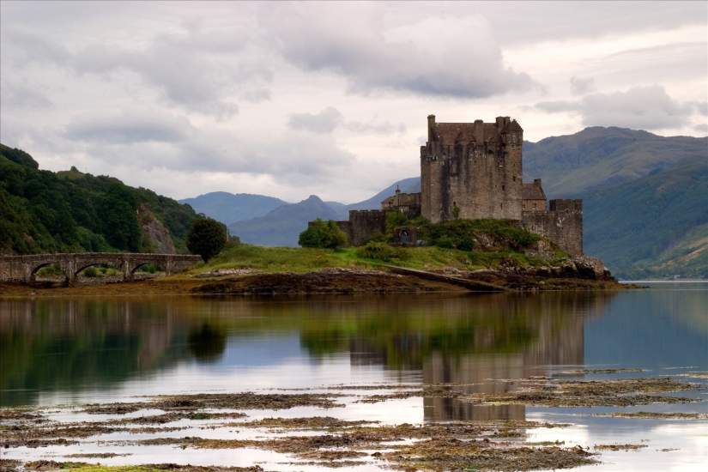
Images of Ireland
Notes:
http://commons.wikimedia.org/wiki/File:Slea_Head_from_Dunbeg_Fort,_Dingle_Peninsula,_Kerry,_Ireland.jpg
https://en.m.wikipedia.org/wiki/File:Aghagower_St_Patrick_Statue_2007_08_12.jpg
http://www.fotopedia.com/items/audioworm-1tpO4KZY3G4

Slide 5
Why did People Decide to Leave Ireland? Push Factors
The Irish Potato Famine
The Great Hunger
Poverty
British Oppression

Slide 6
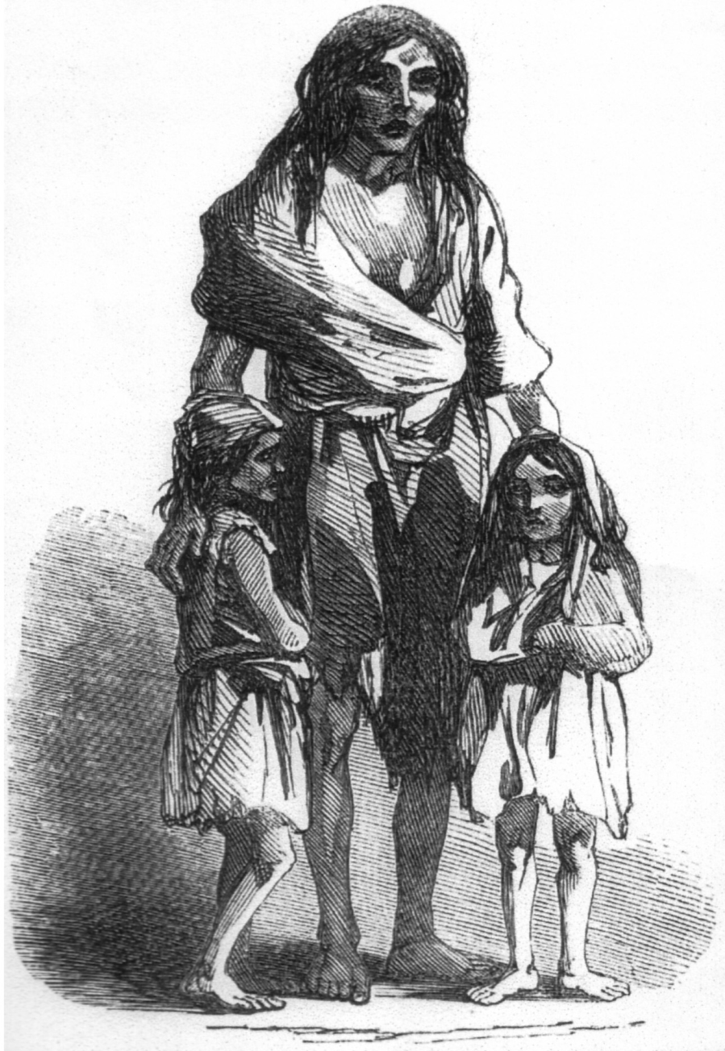
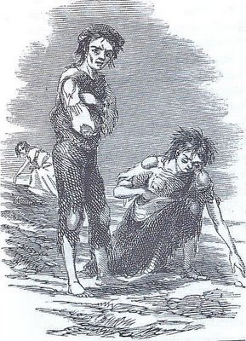
Why did People Decide to Leave Ireland?
Notes:
http://nabnyc.blogspot.com/2010/03/irish-potato-famine-and-diaspora.html
https://commons.wikimedia.org/wiki/File:Irish_potato_famine_Bridget_O'Donnel.jpg

Slide 7
Why Choose America?
Promise of Freedom (religious and political)
Hope for a new life
Jobs
Land
“Streets paved with gold”

Slide 8
What Irish Immigrants Anticipated.
Notes:
http://www.flickr.com/photos/72527902@N00/1969560445/
http://www.wpclipart.com/money/bag_of_money.png.html
http://www.123rf.com/photo_14900487_happy-family-near-new-house.html

Slide 9
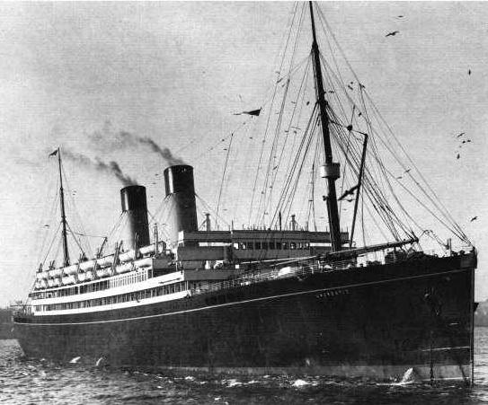
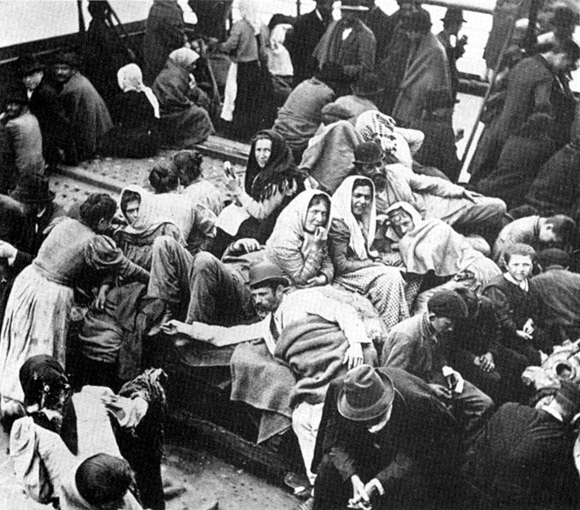
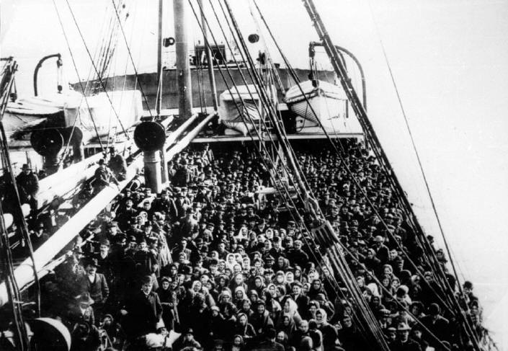
Getting to America
Notes:
http://moodleshare.org/mod/page/view.php?id=10574

Slide 10
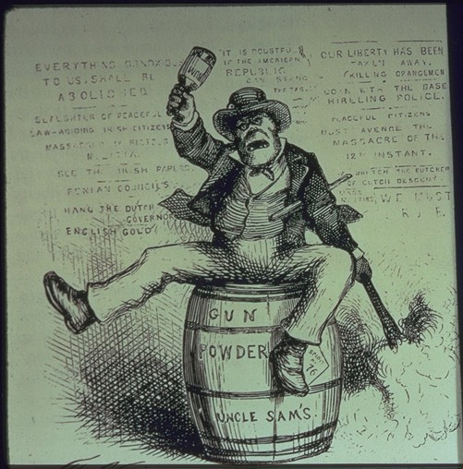
What America Was Really Like When You Arrived
Notes:
http://upload.wikimedia.org/wikipedia/commons/6/66/TheUsualIrishWayofDoingThings.jpg
http://ravenseniors.wikispaces.com/file/view/21075433.gif/315171862/21075433.gif

